Slide 1
Project Presentation of Industry Oriented Hands on Experience (22CS422)
On
UB E-Health: AI-Powered Integrated Healthcare & Hospital Management System
Shaishav | Sangram Jyoti Patra
2211985046 | 2211985045
Supervised By
Dr. Rajat Takkar, Assistant Professor, Dept. of CSE
Department of Computer Science and Engineering,
Chitkara University, Punjab

Slide 2
Table of Contents
1. Introduction & Problem Background
2. Project Objectives & Scope
3. System Architecture Overview
4. Development Methodology (Agile Sprints)
5. Tools & Technologies — Frontend
6. Tools & Technologies — Backend & DB
7. System Diagrams — Use Case & Class
8. System Diagrams — Component & ER
9. Application Screenshots — Patient
10. Application Screenshots — Doctor & Messaging
11. AI Features & Security Outcomes
12. Conclusion & Future Scope
2

Slide 3
Introduction — Problem Background
Conventional healthcare relies heavily on manual processes and paper-based records
Patients face difficulty scheduling appointments, accessing reports, and understanding clinical terminology
Doctors struggle with disorganised patient histories and inefficient prescription workflows
Lab staff manage test requests manually — causing delays, lost samples, and entry errors
No unified digital platform results in poor coordination between departments
Increased administrative burden on staff and delayed access to medical information
Unnecessary in-person visits for minor queries reduce quality of patient care
Especially critical in resource-limited or offline healthcare environments
3

Slide 4
Scope of the Project
IN SCOPE
Web-based app accessible via modern browsers
Four roles: Patient, Doctor, Lab Personnel, Admin
Appointment booking with online payment (Razorpay)
Lab test management with home service option
AI report interpretation (Gemini + Ollama fallback)
Real-time doctor-patient messaging (Socket.io)
Prescription management with PDF generation
Health trend analytics & visualization
Email notification system with cron scheduling
Ambulance service management
OUT OF SCOPE
Mobile native application (iOS / Android)
Video consultation via WebRTC
Integration with external hospital ERP systems
Medical imaging analysis (X-ray, MRI interpretation)
4

Slide 5
System Architecture Overview
MERN Stack Full-Stack Web Application
Frontend: React.js :3000 → REST API (HTTP) + WebSocket
Backend: Node.js + Express.js :3001
Database Layer: MongoDB (data) + Redis Cache (presence / rate-limiting)
Real-Time: Socket.io Server for doctor-patient chat
AI Services:
• Google Gemini API (Online cloud AI)
• Ollama Local Model (Offline fallback)
• Rule-Based Engine (Final fallback)
Email: Gmail SMTP via Nodemailer
Security: JWT Auth + bcrypt hashing + input sanitization + MIME validation
5

Slide 6
Development Methodology — Agile Sprints
Sprint 1: Auth & Users
Patient / Doctor / Admin / Lab registration
JWT authentication middleware
Role-based route protection
Sprint 2: Appointments & Lab
Appointment booking with slot management
Lab test booking + home service
Razorpay integration + email notifications
Sprint 3: Records & Prescriptions
Doctor report creation with vitals
Prescription mgmt + PDF generation
Document upload & sharing
Sprint 4: AI Integration
Google Gemini API for report interpretation
Ollama local AI fallback
Rule-based fallback + health chatbot
Sprint 5: Real-Time Chat
Socket.io server setup
Redis for caching & presence
Doctor-patient chat + typing indicators
Sprint 6: Analytics & Polish
Health trends analytics dashboard
Health score calculation system
Admin dashboard + responsive UI
6

Slide 7
Tools & Technologies — Frontend
React.js v18 — Component-based UI; virtual DOM for efficient rendering
Redux — Centralized state management; unidirectional data flow
React Router v6 — Client-side routing with protected routes for role auth
Axios — Promise-based HTTP client with request/response interceptors
Chart.js + react-chartjs-2 — Interactive health trend charts (vitals over time)
jsPDF — Client-side PDF generation for prescriptions and appointment receipts
React-Toastify — Non-intrusive success / error / info notifications
socket.io-client — WebSocket connections for real-time doctor-patient chat
7

Slide 8
Tools & Technologies — Backend & Database
Node.js — Non-blocking event-driven JavaScript runtime; ideal for real-time I/O
Express.js v4 — REST API framework with middleware and routing
Socket.io v4 — Bidirectional real-time communication with WebSocket + HTTP fallback
JWT (jsonwebtoken) — Stateless authentication; token carries userId and role
bcrypt — Password hashing with salt; prevents rainbow table attacks
Multer — Middleware for multipart file uploads (medical docs, chat attachments)
MongoDB + Mongoose v6 — NoSQL document DB with ODM schema, validation & populate()
Redis (ioredis) — In-memory store for presence, typing indicators, rate limiting
Nodemailer + node-cron — Automated appointment / medication email reminders
Winston — Audit logging for chat, auth failures, and security events
8

Slide 9
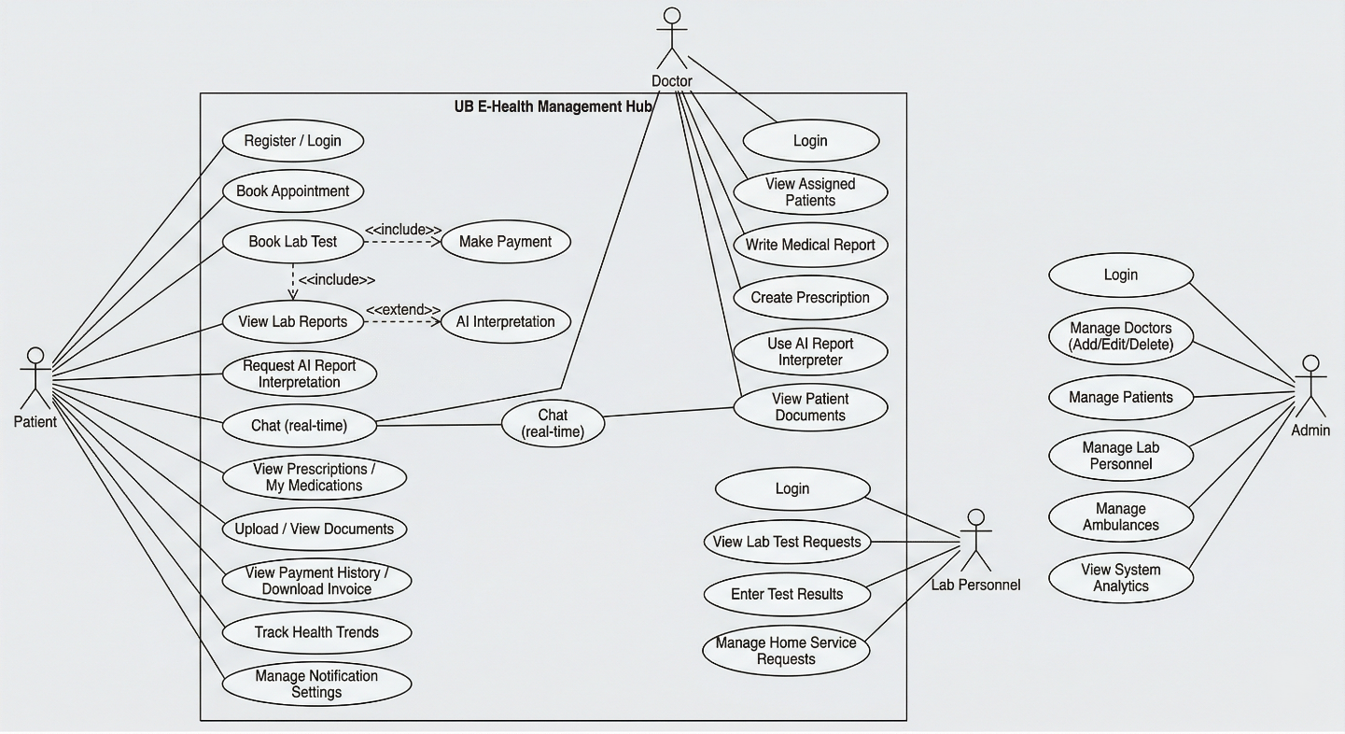
System Diagrams — Use Case Diagram
Four actor roles: Patient, Doctor, Lab Personnel, Admin — with AI report interpretation and real-time chat interactions
9

Slide 10
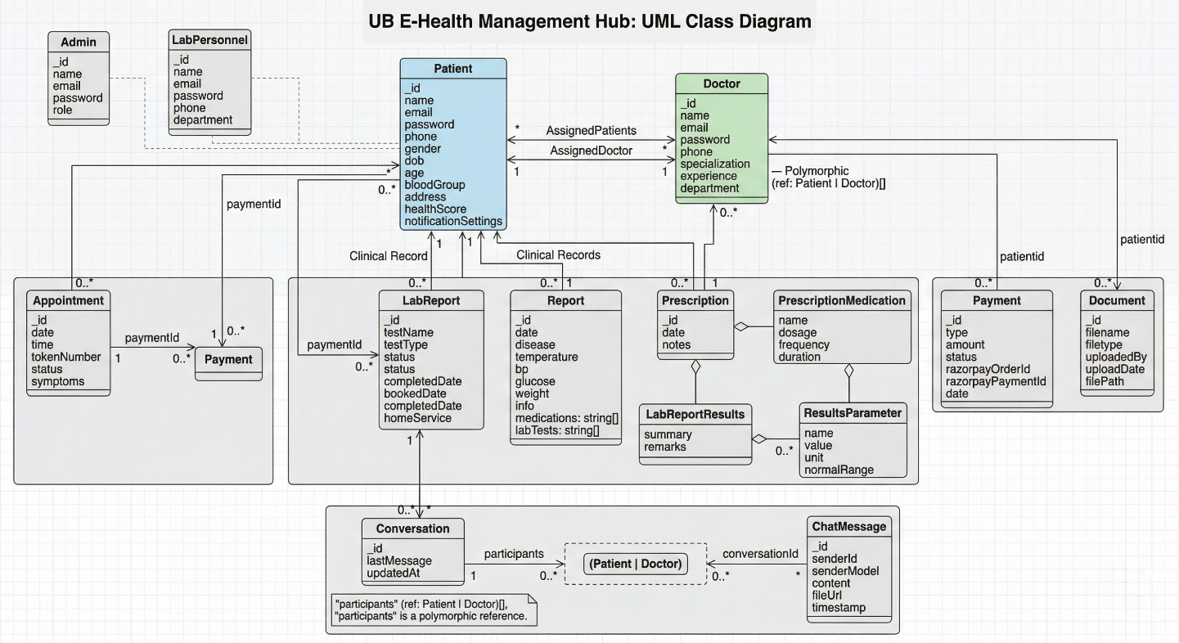
System Diagrams — UML Class Diagram
Core entities: Patient, Doctor, LabPersonnel, Admin with relationships to Appointment, LabReport, Prescription, Conversation, ChatMessage, Payment, Document
10

Slide 11
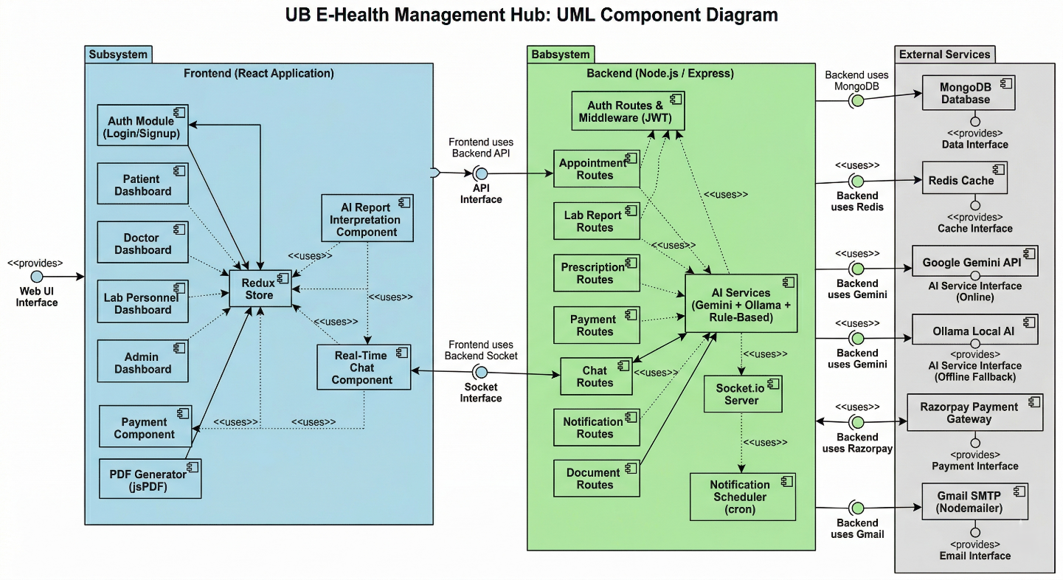
System Diagrams — UML Component Diagram
Frontend (React + Redux Store) communicates with Backend (Express routes, AI services, Socket.io, Notification Scheduler) and External Services (MongoDB, Redis, Gemini, Razorpay, Gmail)
11

Slide 12
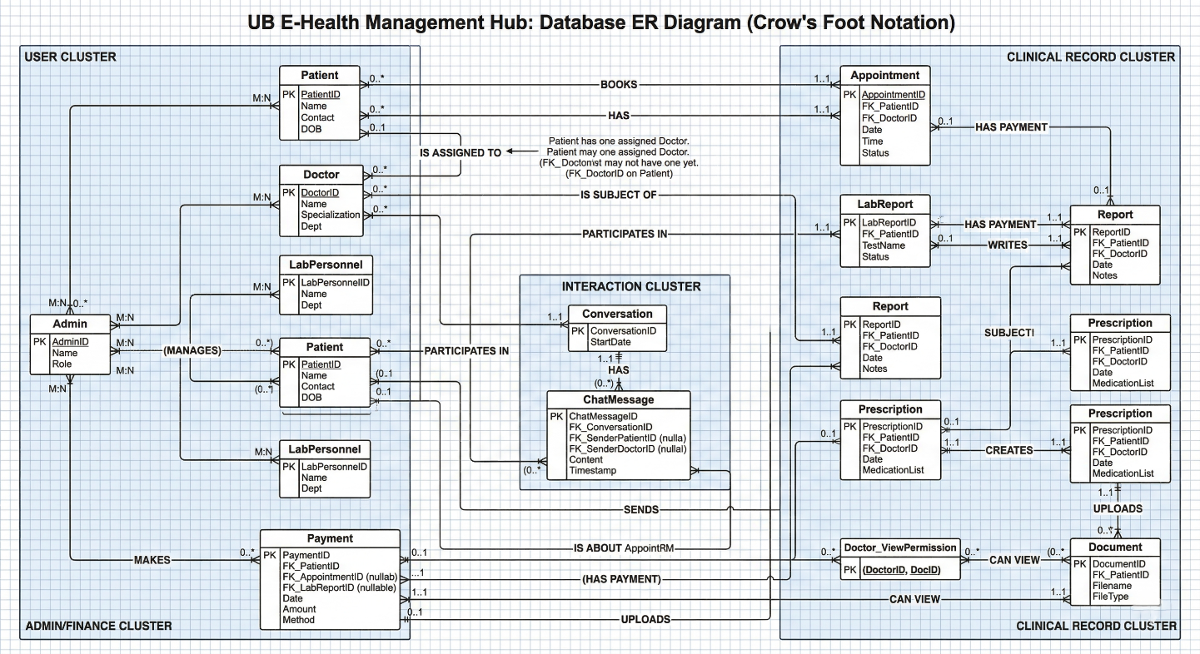
System Diagrams — Database ER Diagram
Crow's Foot Notation: User Cluster (Patient, Doctor, LabPersonnel, Admin), Clinical Record Cluster (Appointment, LabReport, Report, Prescription), Interaction Cluster (Conversation, ChatMessage)
12

Slide 13
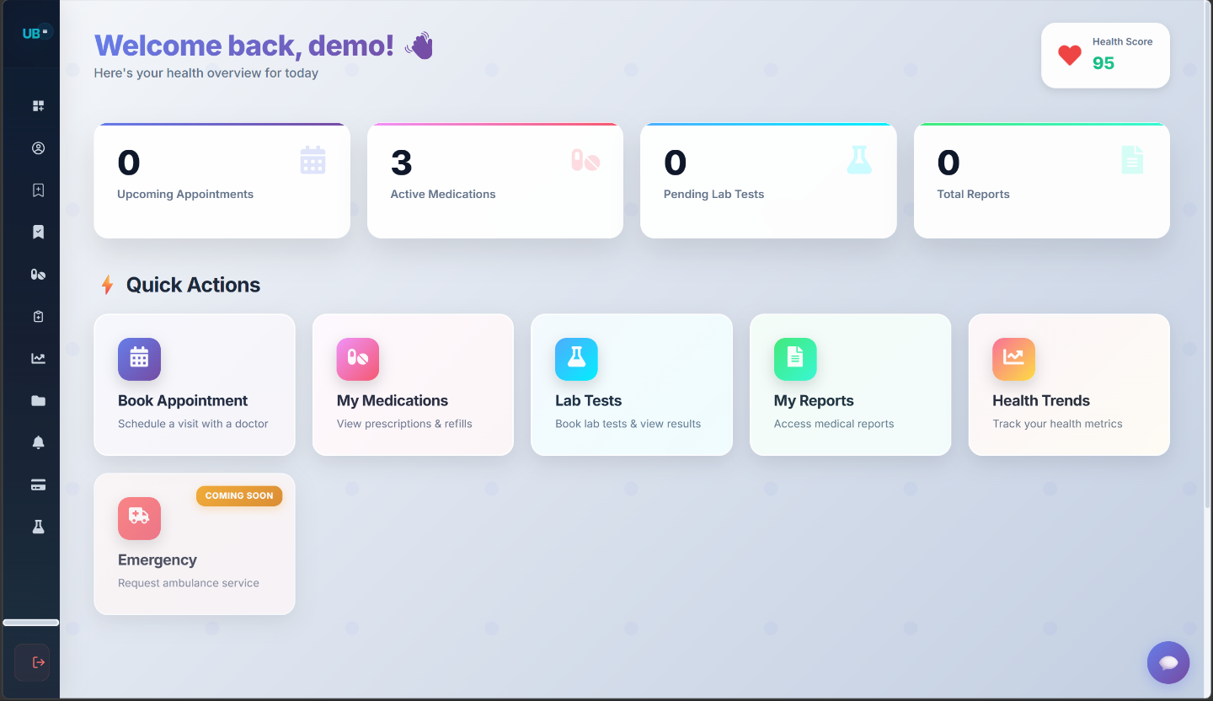
Application Output — Patient Dashboard
Patient Dashboard
Health Score indicator (0-100)
Stat cards: Upcoming Appointments, Active Medications, Pending Lab Tests, Total Reports
Quick Action tiles: Book Appointment, My Medications, Lab Tests, My Reports, Health Trends
Emergency (Ambulance) service — Coming Soon
13

Slide 14
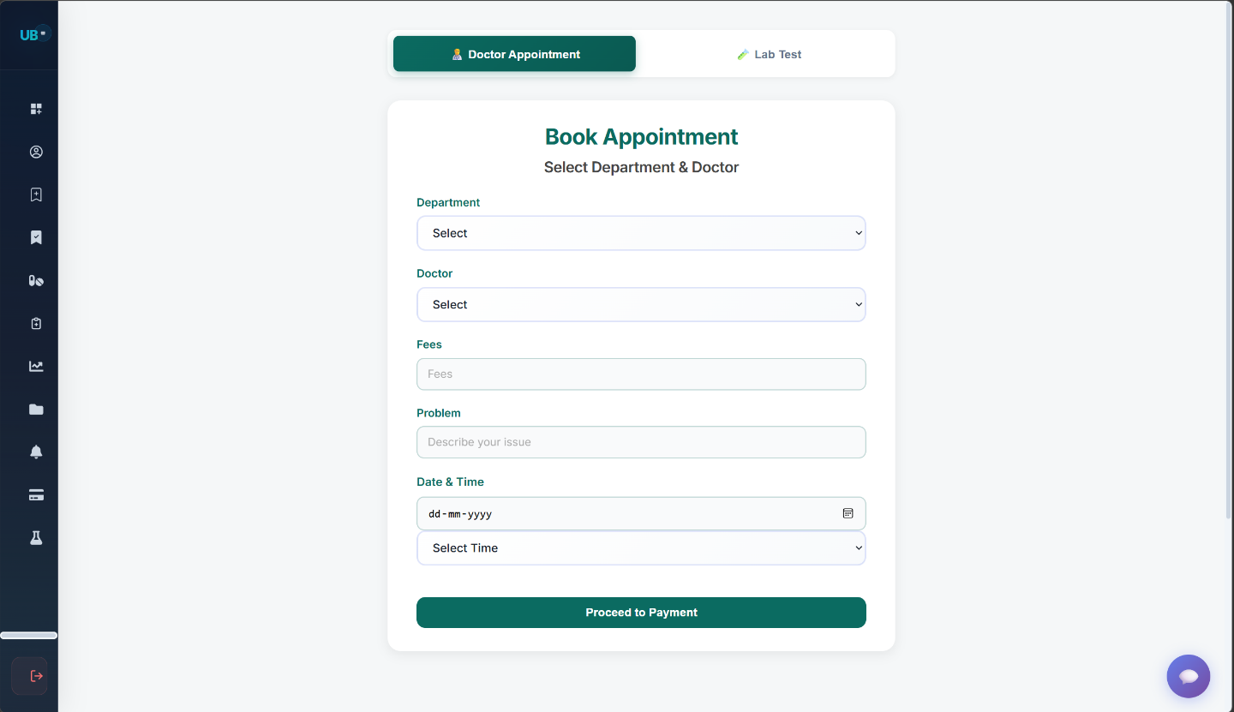
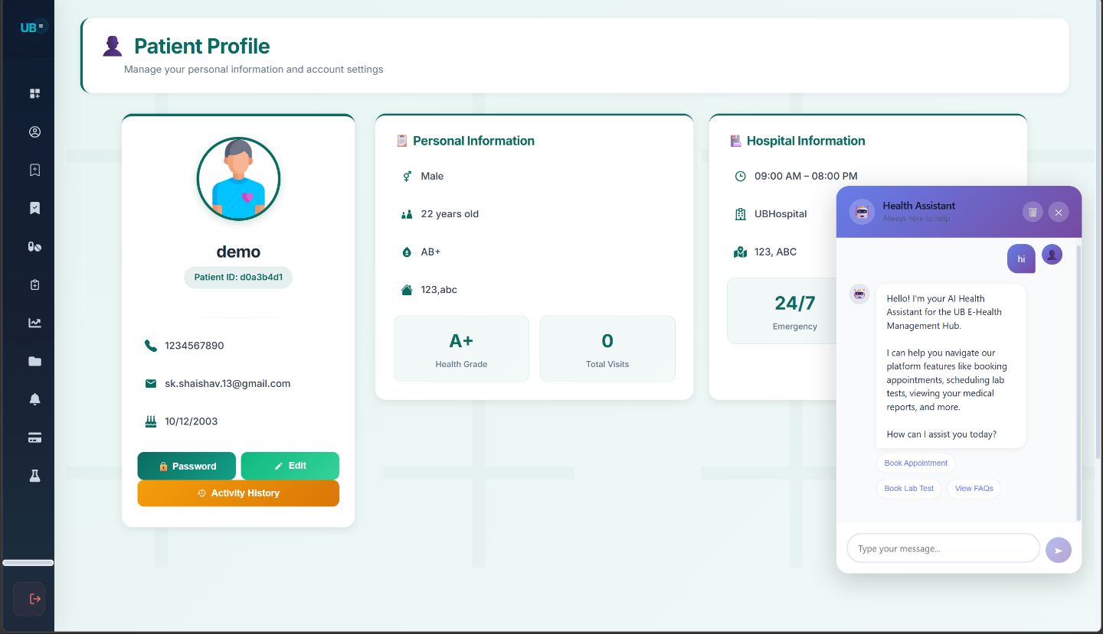
Application Output — Appointment Booking & AI Chatbot
Appointment Booking Form: Select Department, Doctor, Date & Time, then proceed to Razorpay payment
Patient Profile + AI Health Chatbot: Personal info, Health Grade, Hospital details, and 24/7 AI assistant
14

Slide 15
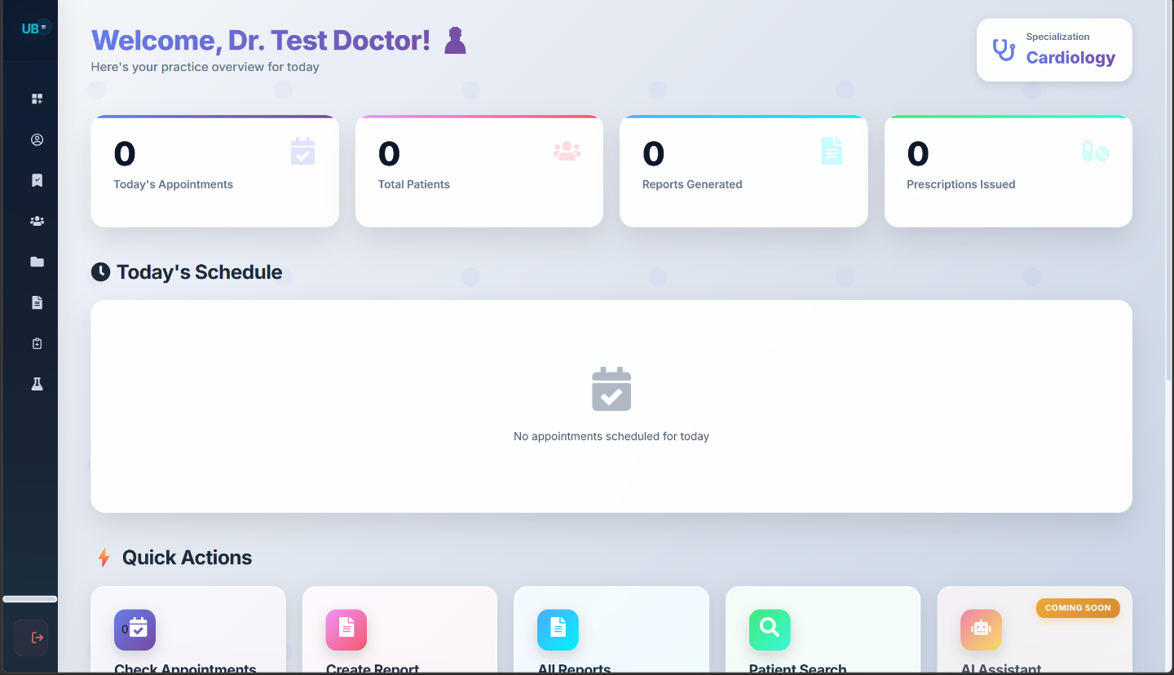
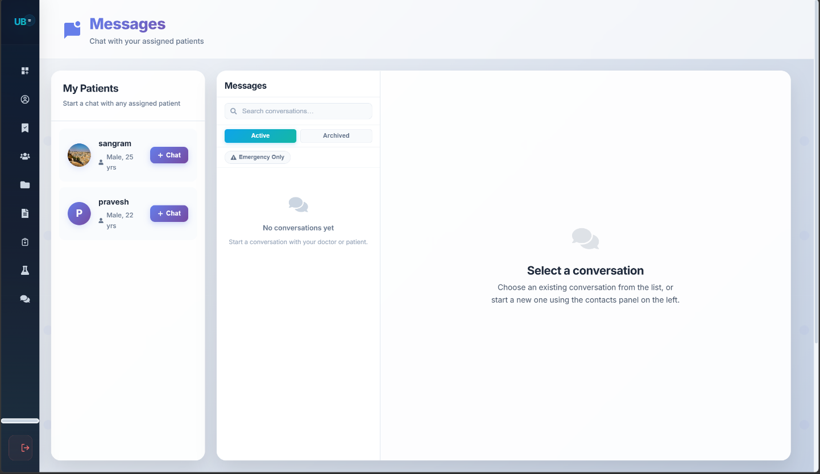
Application Output — Doctor Dashboard & Messaging
Doctor Dashboard: Today's Appointments, Total Patients, Reports Generated, Prescriptions Issued — with Quick Actions
Real-Time Messaging: Doctor-Patient chat via Socket.io; My Patients list with active conversations and emergency-only mode
15

Slide 16
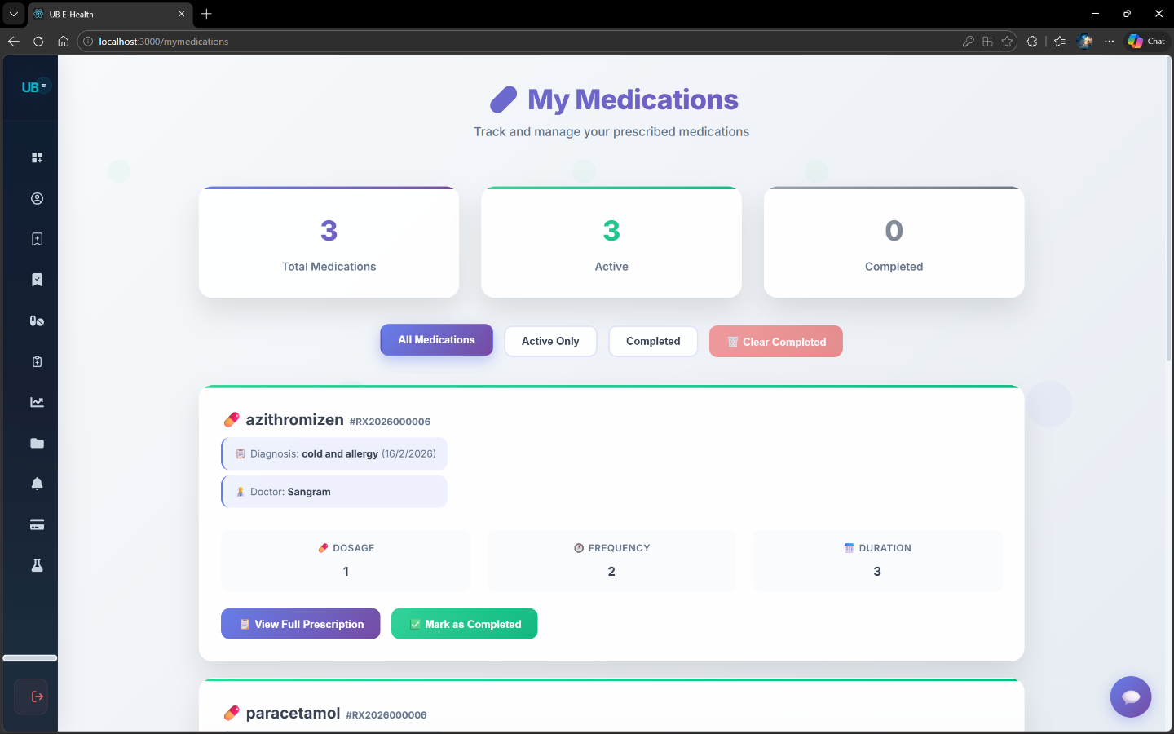
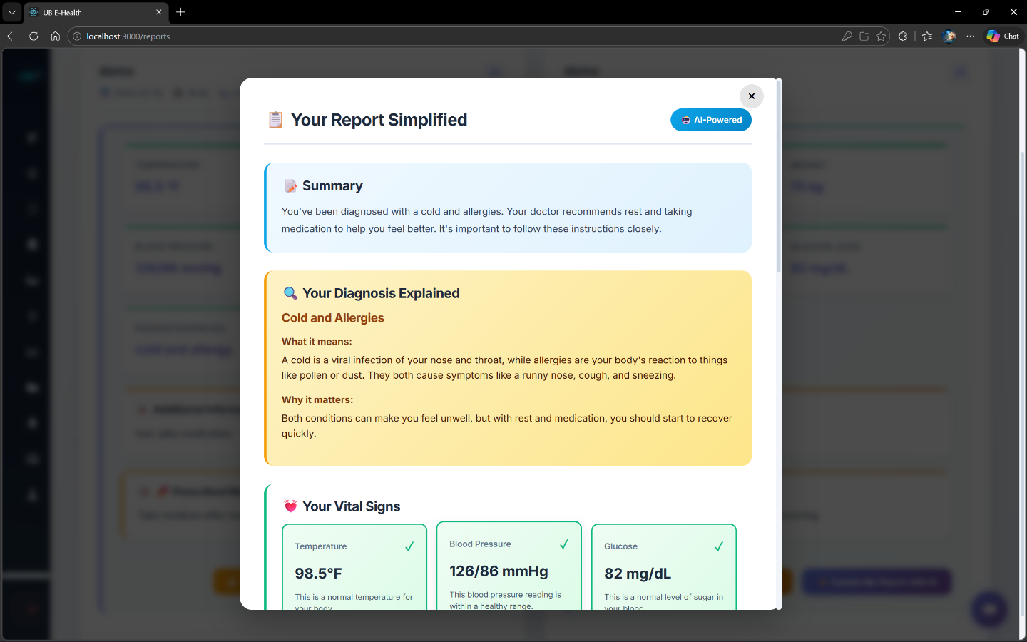
Application Output — Medications & AI Report Interpreter
My Medications: Track active prescriptions — Dosage, Frequency, Duration — with View Full Prescription and Mark as Completed
AI Report Simplified: Executive Summary, Diagnosis Explained, Vital Signs — all in plain patient-friendly language powered by Google Gemini
16

Slide 17
AI Features & Security Outcomes
AI Feature Outcomes
Patient Comprehension: Lab reports translated to plain language without medical training
Offline Availability: Ollama fallback keeps AI functional in rural/offline settings
Structured Output: JSON response in sections — Summary, Parameter Explanations, Recommendations, Doctor Questions
Safety Disclaimer: Every interpretation includes a reminder to consult their doctor
Security Outcomes
XSS Prevention: All user inputs sanitized; script tags stripped via DOMPurify
Injection Prevention: ObjectId validation prevents NoSQL injection attacks
Unauthorized Access: Role middleware blocks all cross-role access attempts
Password Security: bcrypt hashing with salt rounds for all stored credentials
File Upload Security: MIME type and file size validation enforced on every upload
17

Slide 18
AI Features & Security Outcomes
AI Feature Outcomes
Patient Comprehension: Lab reports translated to plain language without medical training
Offline Availability: Ollama fallback keeps AI functional in rural/offline settings
Structured Output: JSON response in sections — Summary, Parameter Explanations, Recommendations, Doctor Questions
Safety Disclaimer: Every interpretation includes a reminder to consult their doctor
Security Outcomes
XSS Prevention: All user inputs sanitized; script tags stripped via DOMPurify
Injection Prevention: ObjectId validation prevents NoSQL injection attacks
Unauthorized Access: Role middleware blocks all cross-role access attempts
Password Security: bcrypt hashing with salt rounds for all stored credentials
File Upload Security: MIME type and file size validation enforced on every upload
18

Slide 19
Conclusion & Future Scope
Conclusion
Successfully built a production-ready AI-powered healthcare management system on the MERN stack
All planned objectives achieved — role auth, appointments, lab tests, prescriptions, AI reports, real-time chat
Dual-mode AI architecture (Gemini + Ollama) — a key original contribution making intelligent interpretation universally accessible
Security implemented at every layer; system tested end-to-end across all modules
Reduces appointment scheduling time, improves patient understanding, centralises hospital workflows
Future Scope
WebRTC video consultation (telemedicine)
React Native mobile app for iOS & Android
Medical image analysis with vision-capable AI (X-ray, MRI, CT)
Wearable device integration (smartwatch health metrics)
Two-Factor Authentication (OTP via SMS)
Multi-language support for regional Indian languages
HL7 FHIR-compliant EHR export for interoperability
HIPAA/DPDP-compliant audit trail and compliance reporting
19

Slide 20
Thank You
UB E-Health: AI-Powered Integrated Healthcare & Hospital Management System
Shaishav | Sangram Jyoti Patra
Roll No: 2211985046 | 2211985045
Department of Computer Science and Engineering
Chitkara University Institute of Engineering and Technology, Punjab
Tech Stack: MERN | Socket.io | Redis | Google Gemini | Ollama | Razorpay | JWT

